Slide 1
Unit 4: Environmental pollution

Slide 2
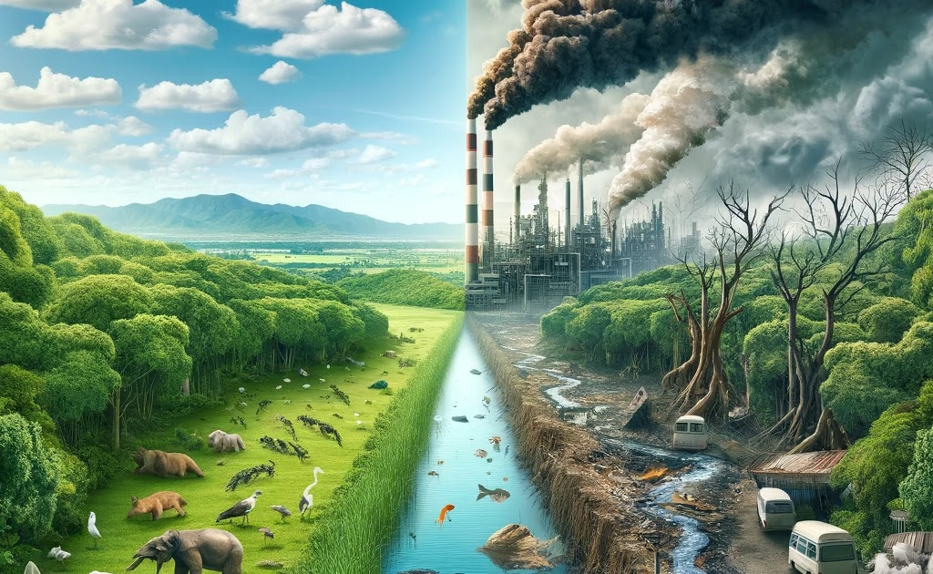
Environmental pollution
Environmental pollution can be defined as any undesirable change in the physical,chemical or biological characteristics of any component of the environment .(air,water,land) which can cause harmful effects on various forms of life.
Pollution can take the form of chemical substances(dust,sediment), biotic component or physical factor, such as noise, heat or light

Slide 3
BROAD CLASSIFICATION OF POLLUTION
A.(on basis of sphere of atmosphere) B. (on basis of type of pollutant)
RADIOACTIVE
SEWAGE
PESTICIDE
NOISE
MARINE
PLASTIC
THERMAL
AIR POLLUTION
WATER
SOIL OR LAND

Slide 4
WATER POLLUTION
DETERIORATION IN PHYSICAL,CHEMICAL AND BIOLOGICAL PROPOERTIES OF WATER DUE TO ADDITION OF FOREIGN MATERIALS(NATURAL OR ANTHROPOGENIC) .

Slide 5
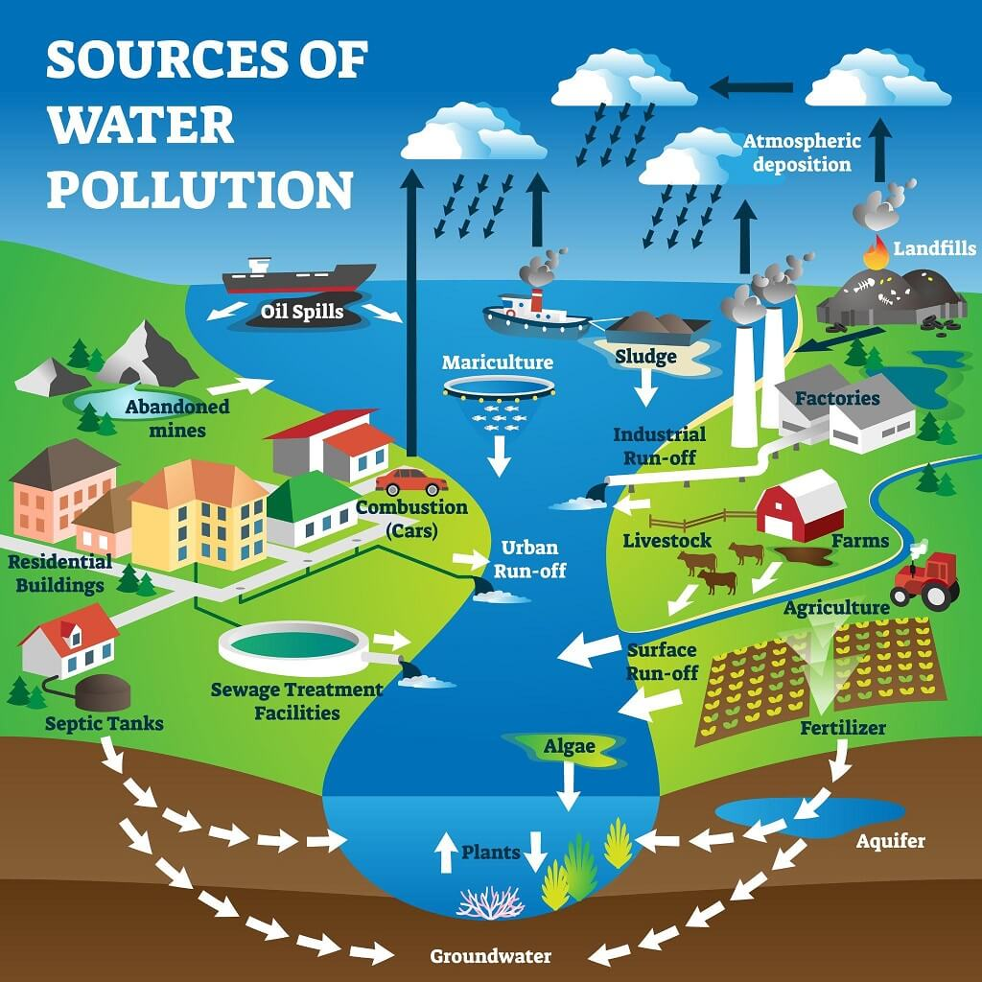

Slide 6
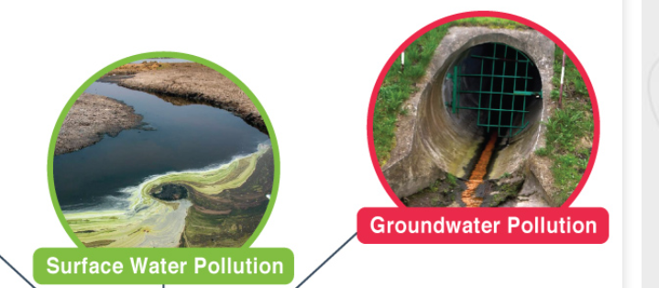
TYPES OF WATER POLLUTION
On the basis of sources and storage it may be divided into 5 categories
Ground water pollution
Surface water pollution
Lake water pollution
River water pollution
Sea water pollution

Slide 7
TYPES OF WATER POLLUTION
On the basis of changes in properties of water, water pollution can be classified mainly into 4 categories
Physical pollution of water
Chemical pollution of water
Biological pollution of water
Physiological pollution of water

Slide 8
Sources of water pollution
SEWAGE AND DOMESTIC WASTES
INDUSTRIAL EFFLUENTS
AGRICULTURAL DISCHARGES
FERTILIZERS
DETERGENTS
TOXIC METALS
SILTATION
THERMAL POLLUTANTS
RADIO ACTIVE METALS

Slide 9
Sources of water pollution
SEWAGE AND DOMESTIC WASTES
Sewage is cloudy dilute solution. Around 75% of water pollution is caused by sewage,domestic wasteandfood processing.Sewage and domestic waste also include human excreta, soap, detergent, metal ,glass etc.
2. INDUSTRIAL EFFLUENTS
They contain toxic chemicals, phenols ,ketones etc. sulphuric acid waste from coal minesis a chronic pollutant that enhances hardness of water and corrodes concrete.
3. AGRICULTURAL DISCHARGES
plant nutrients,pestcicides, fertilizers,insectisides etc .
NPK fertilizers (nitrate+phosphate) when washed off towater affect aquatic life
Nitrites enter blood stream and cause mathemoglobenimia disease.(Lack of oxygen in blood) which damages respiratoty sytem.

Slide 10
Sources of water pollution
4. FERTILIZERS
Indiscriminate and excessive use of fertilizers on land , has also created ecological effect on acqautic sytem. Nitrates cause blue baby syndrome (mathemoglobinemia(lack of oxygen) in which damage is caused to the respiratory and vascular system.
5. DETERGENTS
Refuse from factory carries huge amount of foam. This foam is unaesthetic and also phosphorous causes eutrophication.
Ex: lakes in bangalore(bellandur),Ulsoor etc.

Slide 11
Sources of water pollution
6.Toxic metals
Mining industry, mettalurgical industry, chemical industry, leather ,sugar, distilleries, battery industry and thermal power plants are main sources of toxic heavy metals.
ex: Minamata disease(consumption due to methyl mercury).Heavy metals such as Hg,Cd,Pb,Co etc are detrimental to acquatic ecosystem and human life.combination of heavy metals with slats with organic compounds in particular is very toxic.
7.SILTATION
siltation consists of dirt and dust particles, which are carried from land to water. Siltation is the most widespread and damaging pollutant especially in the hilly areas.

Slide 12
Sources of water pollution
8.THERMAL POLLUTANTS
Waste from thermal(coal),atomic( and nuclear). Cause high temperature, DO in water decreases, threatens acquatic life.
9.RADIO ACTIVE
Materials in water-nuclear plants ,nuclear reactors,
nuclear installations enter food chain. Deposit in body organs and deliver radiation

Slide 13
EFFECTS OF WATER POLLUTION
Pollutants impart color,odour and taste.
Causes chemical reactions
Organic matter decreases oxygen content
Nutrients in wastes enhance Algal bloom leads to eutrophication(combination of nitrates and phosphates)
Algal photosynthesis releases CO2.
Pathogens lead to water borne diseases.
Chemicals, heavy metals are detrimental to human
health and acquatic.

Slide 14
CONTROL OF WATER POLLUTION
Judicious use of agrochemicals
Use of nitrogen fixing plants
Adopting pest management
Prevent run-off manure
Separate drainage of sewage and rain-water
Planting trees would reduce pollution

Slide 15
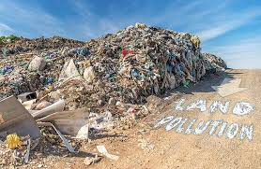
LAND POLLUTION
Soil pollution is the introduction of substances, biological organisms, or energy into the soil which affects soil quality.
Sources: Industrial radio active urban agricultural.
Chemical and Metallic Biological Agents minning.

Slide 16
EFFECTS OF LAND POLLUTION
Pathogenic soil bacteria are chronic health disease carrier, which is transmitted from soil to man(defacation) causing diseases like cholera, typhoid, dysentery etc. Viruses add to pollution in soil.
Soil provides best medium for growth of eggs, larve, flies etc causing diseases like malaria, filariasis etc.
Hazardous chemicals and metals can percolate into ground water and make water unfit for drinking.
Hazardous substances accumulate in soil and water and can be transferred organisms.ex:24 villages in Gujarat have recently been using heavy industrial effluents for agriculture.

Slide 17
LAND POLLUTION
Radioactive fallout on vegetation ,enters into food chain and effects grazing animals and then humans(strontium -90 deposits in bone causing bone deformities and brittleness ).

Slide 18
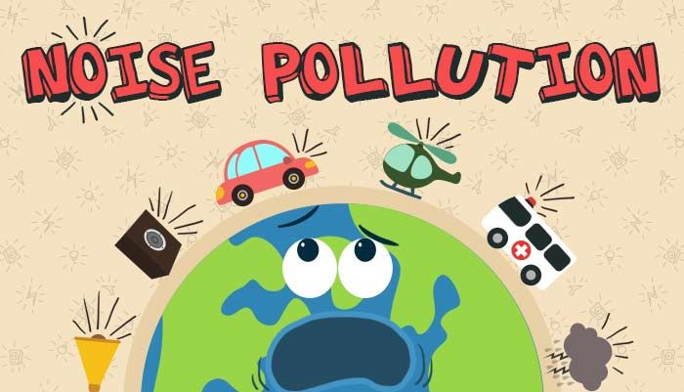
NOISE POLLUTION
Noise pollution is defined as any electromagnetic signal that produces jarring or displeasing effect and which interfers with human communication , comfort and health.
Noise pollution Is a slow agent of death.

Slide 19
MEASUREMENT OF NOISE
Noise is usually measured by:
1.Sound pressure or 2.Sound intensity
The sound intensity is measured in Decibel is ratio expressed as logarithmic scale relative to reference sound pressure level. dB is thus expressed as:
Sound intensity level=log intensity measured (I)/Refernce intensity)(IO)
dB=log( I/IO)

Slide 20
MEASUREMENT OF NOISE
Permissible limits: DIVIDED INTO 4 ZONES
Industrial-75dB
Commercial-65dB
Residential-50dB
Audible-50dB

Slide 21
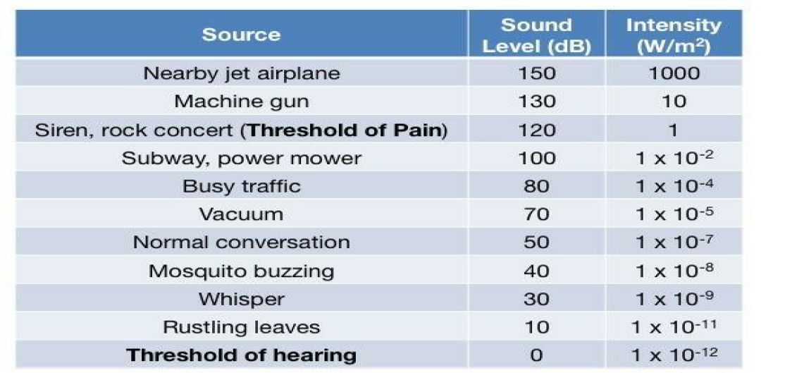
MEASUREMENT OF NOISE

Slide 22
SOURCES OF NOISE POLLUTION
It is broadly classified into 3 categories:
Transport noise- A.Road B.Aircraft C.Rail
Occupational noise
Neighbourhood noise
1.Transport noise-
Road –vehicles on road produce more irritation than any other source of noise. This is because of the steady increase of the no of the road vehicles and consequent increase of road traffic intensity.
Aircraft-This is causing much more discomfort than road transport. noise produced by high speed jet aircrafts is disturbing not only human communication ,comfort ,health but also damaging hearing permanently.
Railway- This is less of a concern compared to other types of traffic noise. It mainly affects buildings close to railway tracks. The use of diesel and electric trains has significantly reduced its impact.

Slide 23
SOURCES OF NOISE POLLUTION
2.Occupational: Mainly produced by industrial machines and processes. Industrial workers are subjected to noise for 8 hrs/6 day
3.Neighbourhood: Disturbance from household items like TV,VCR,
vaccum cleaners,mixers,loud speakers

Slide 24
Effects of noise pollution
Causes physiological and psychological effects. They can be Classified under auditory and non auditory
Auditory- Most immediate effect is impairing of hearing
Non- auditory - Interference with speech communication, mental discomfort, anxiety, insomnia, hypertension, cardio vascular diseases.

Slide 25
Control Measures of noise pollution
Reduction of noise at source
Reduction of transmission of noise or duration of exposure
Protection of receiver

